Slide 1

Department of Computer Science and Engineering Academic Year (2024-25) 22CSE48 - Mini Project using Java Mini Project Competition AES Encrypted Chat Web Application
Team Members
1NH23CS075 - Divya Sirvi – IV B
1NH23CS100 - Jennifer B Abraham – IV B
Date:09-05-2025
Venue: Lab-6

Slide 2
Contents
Objectives
Abstract
Problem Definition
Requirement Specification
Design
Methodology
Implementation
Result
Conclusion

Slide 3
Objectives
Develop a real-time chat application for students and counsellors using Java and Swing for an interactive GUI.
Implement secure user authentication with encrypted credential storage to ensure data privacy.
Allow students to view and select counsellors based on their preferences and needs.
Enable real-time communication using client-server architecture.
Ensure end-to-end message security through AES encryption, providing an additional layer of privacy.

Slide 4
Abstract
The AES Encrypted Chat Application aims to build a secure chat webpage where students can communicate with counsellors in real time after logging in with their credentials.
The login page presents an option to either login as counsellor or as a student.
Allow students to initiate chats with available counsellors.
Enable real-time messaging upon counsellor approval.
AES encryption will be applied to ensure message confidentiality.
The project aims to demonstrate the integration of security mechanisms in a web-based chat system.

Slide 5
Problem Definition
Lack of a secure communication platform between students and counsellors.
Absence of real-time interaction in many traditional systems.
Risk of unauthorized access to sensitive student-counsellor discussions.
Students have no option to choose counsellors based on specific needs.
Need for a dedicated, role-based login system to separate student and counsellor access.
Ensuring end-to-end encrypted messaging to maintain trust and confidentiality.

Slide 6
Requirement Specification
Functional Requirements:
Login system with role (Student/counsellor)
AES encryption for message security
Counsellor selection by student, Chat session request and approval
Real-time chat between authenticated users
Non-functional Requirements:
Secure credential storage
Fast and responsive Swing UI
Scalable for more users and features

Slide 7
Requirement Specification
Hardware Requirements:
Processor: Intel Core i3 or higher
RAM: 4GB minimum
Storage: 20GB free disk space
Software Requirements:
Java Development Kit (JDK 8)
MySQL Database
VS Code
Java Swing
WebSocket API
AES Encryption Libraries

Slide 8
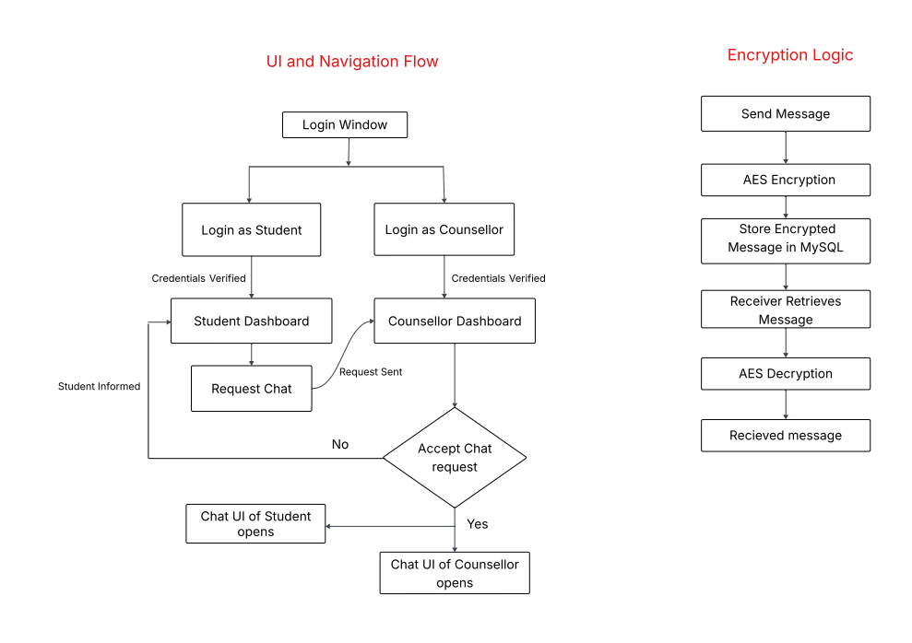
Design
Block diagram

Slide 9
Methodology
Frontend Development: UI using Java Swing, user authentication form.
Backend Development: Java Servlet-based server.
Database Setup: Tables for user authentication and message logs, encrypt stored passwords using hashing.
4. Encryption Mechanism: AES encryption for secure message transmission.
5. Testing, Debugging & Deployment: Ensure real time messaging works correctly and verify encrypted data.

Slide 10
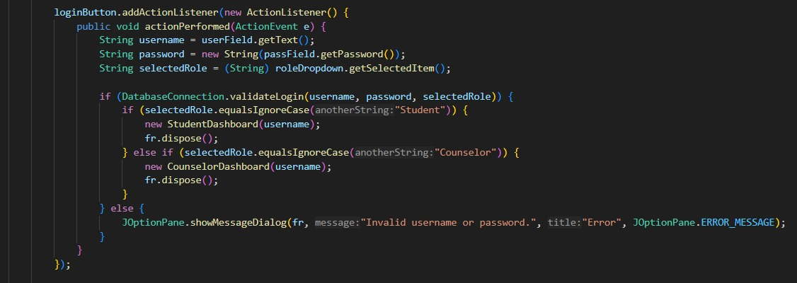
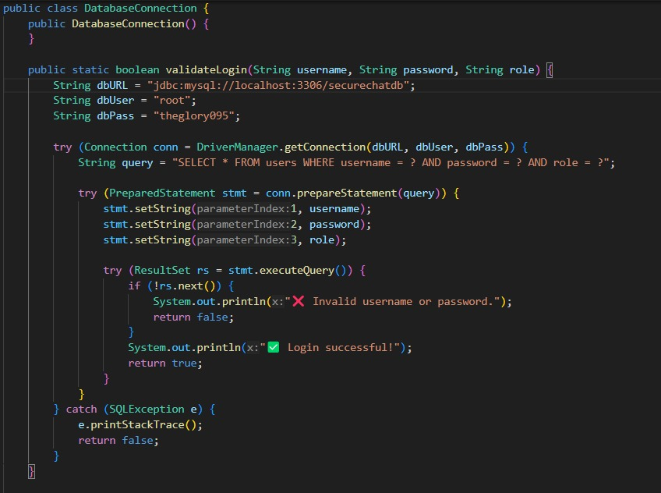
Implementation
Login Window
This window allows the user to login to the application to chat with counsellors. User credentials are stored in MySQL Database. When the user enters their credentials – it is validated from the database to proceed to the dashboard.
Pseudo code for Login Window and Authentication from the database

Slide 11
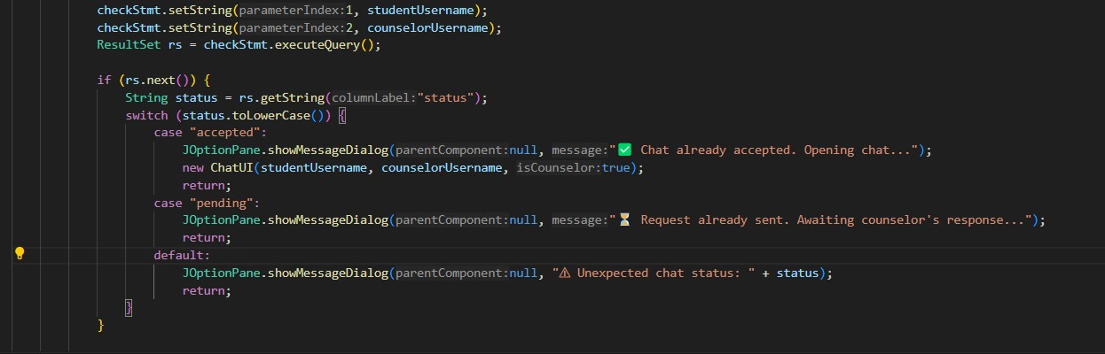
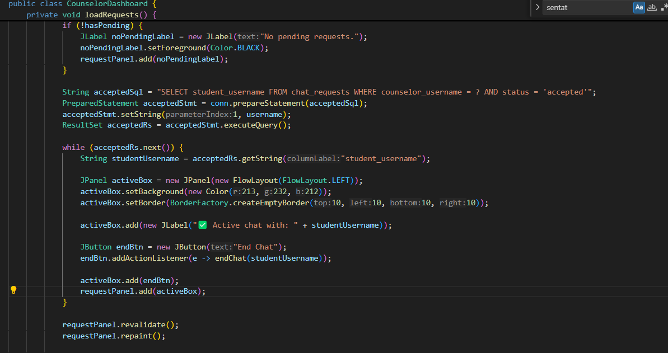
B. Dashboards The student dashboard contains panels, with information about available counsellors and the option to send a chat request to a suitable counsellor. The counsellor dashboards presents a list of student requests which the counsellor can choose to accept or reject. If accepted, individual Chat Windows open for Counsellor and Student. If rejected, student is informed.
Pseudo code for Student Dashboard
Pseudo code for Counsellor Dashboard

Slide 12
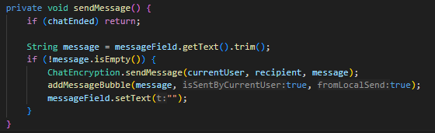
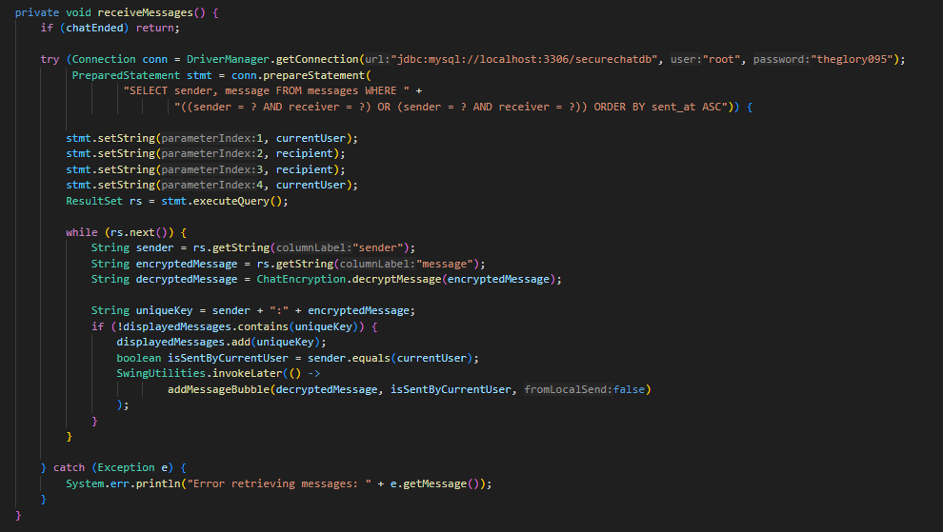
C. Chat Window The chat window provides a safe space for the student to chat with the counsellor. Messages in this space are encrypted using AES algorithm and are hence secure. Chat history is retained so that student and counsellor can go over previous talks to get a clear idea of where they left off.
Pseudo code to send messages
Pseudo code to receive messages

Slide 13
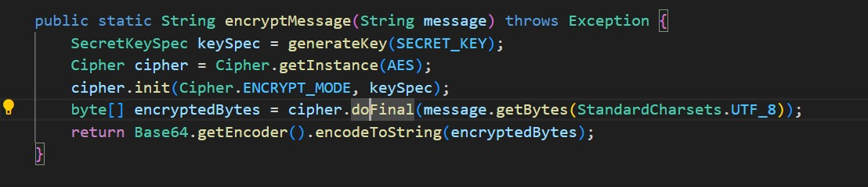
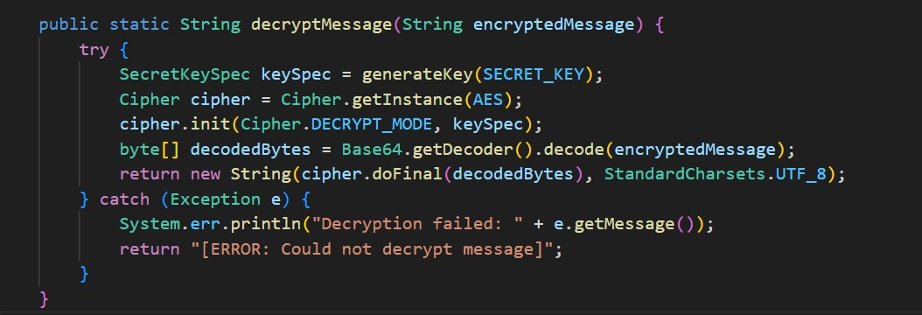
D. AES Encryption This web application uses AES(Advanced Encryption Standard) algorithm to encrypt and decrypt messages. A 16 bit key is used for the process and cipher class is used for effective encryption. Messages sent by user are encrypted and stored in the database, similarly- received messages are retrieved and decrypted using the secret key.
Pseudo code for Encryption
Pseudo code for Decryption

Slide 14
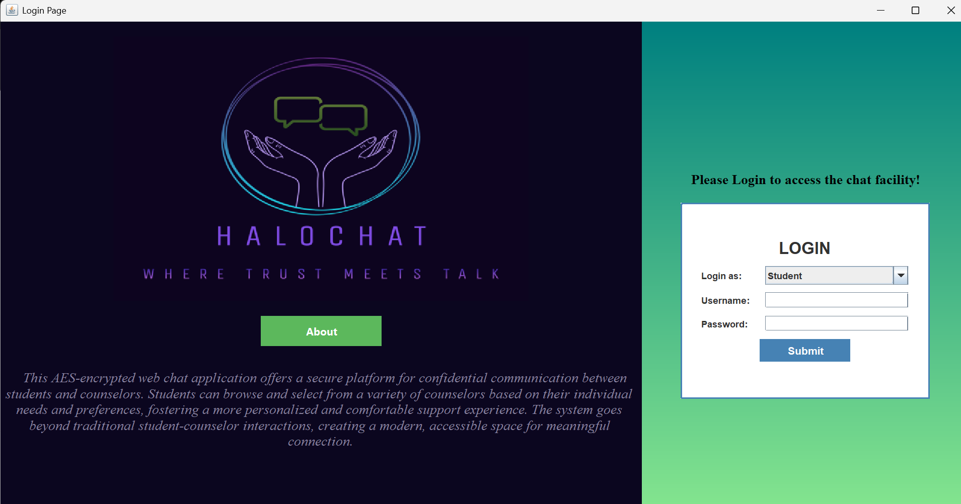
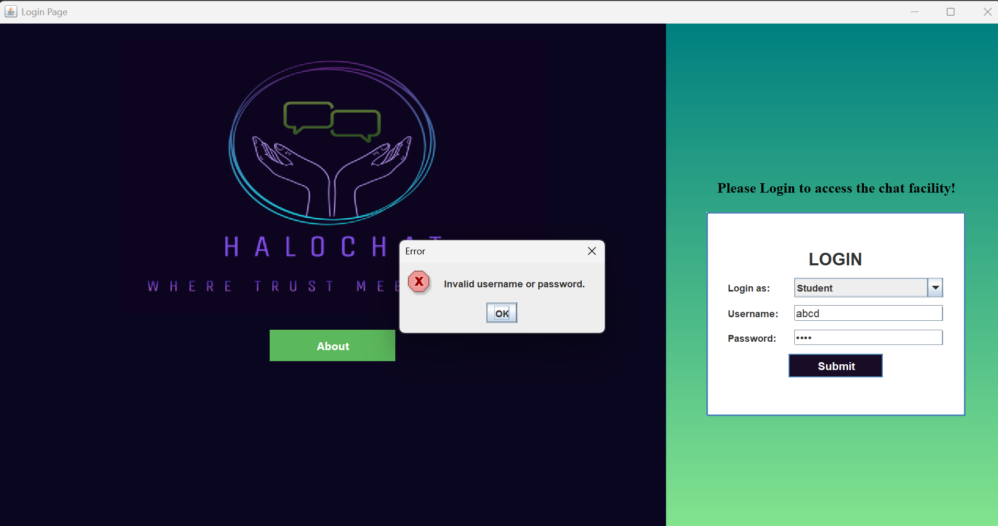
Result
A. Login Window
User Role Authentication
Access Denied – Invalid Credentials

Slide 15
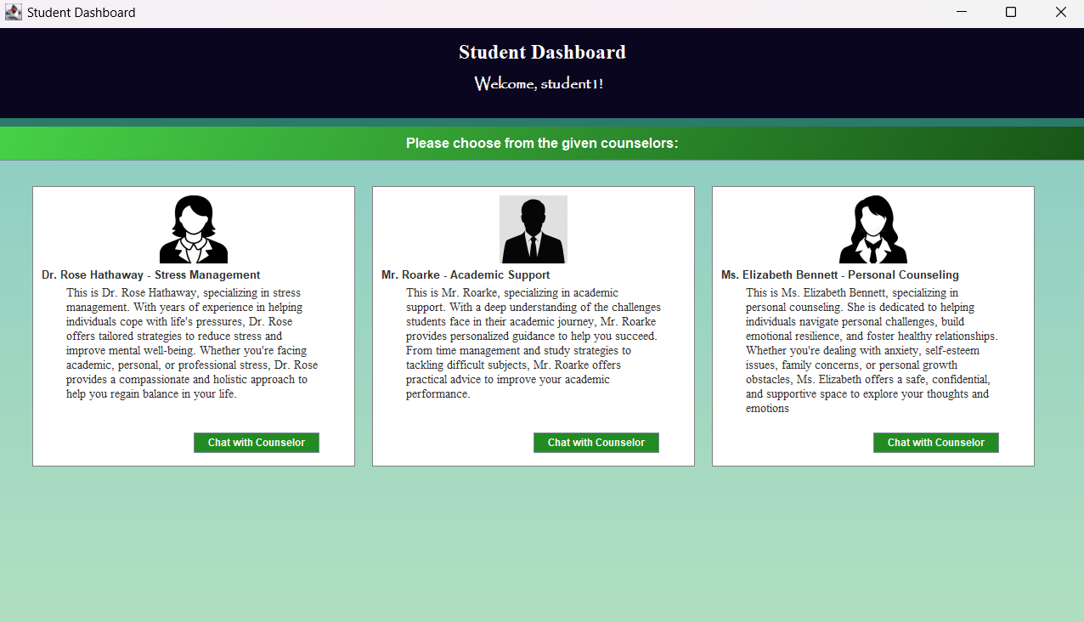
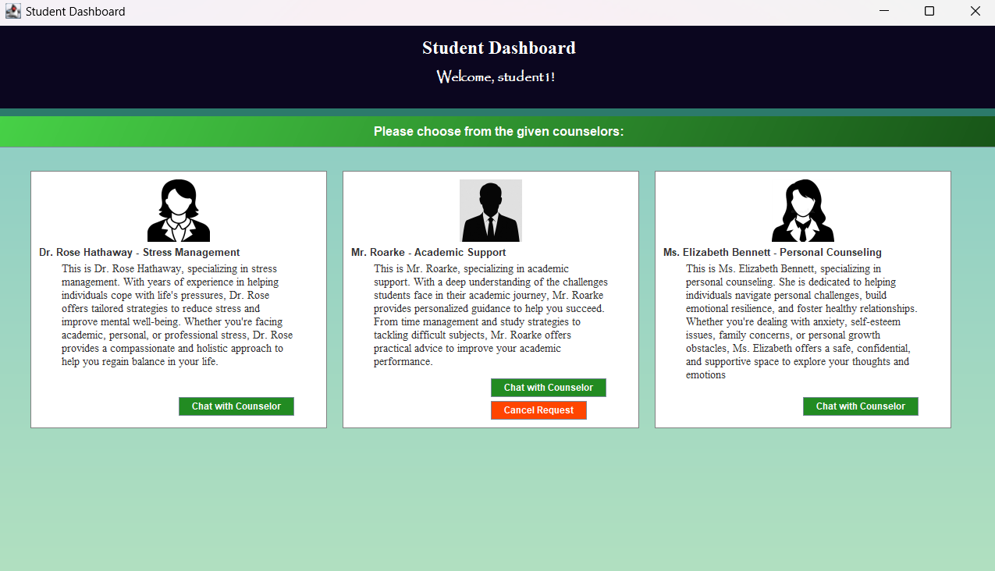
B. Student Dashboard
Student dashboard-general layout
Student dashboard-Request Sent to counsellor

Slide 16
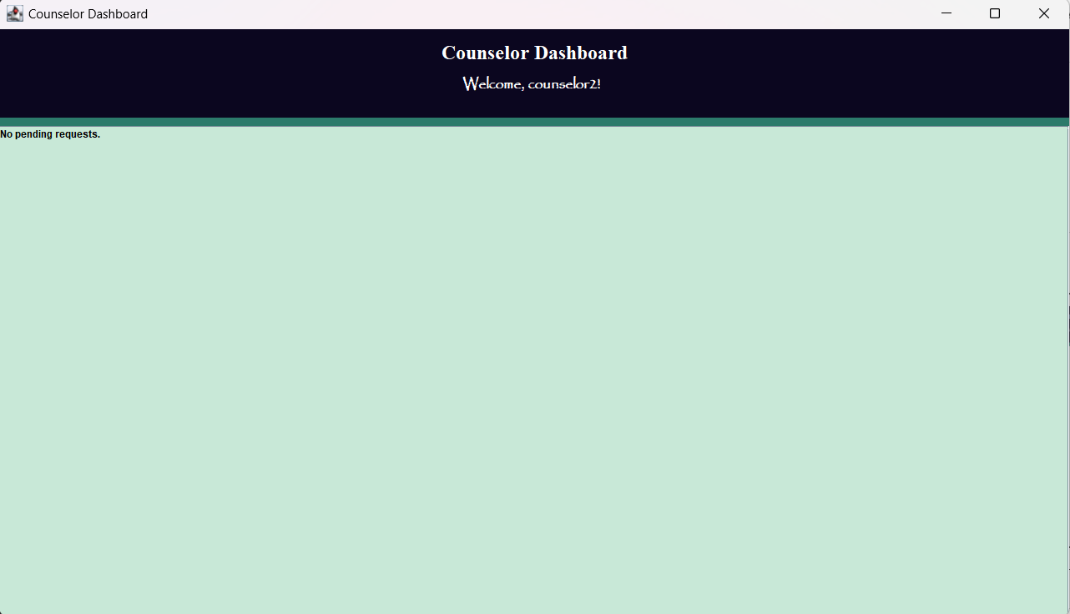
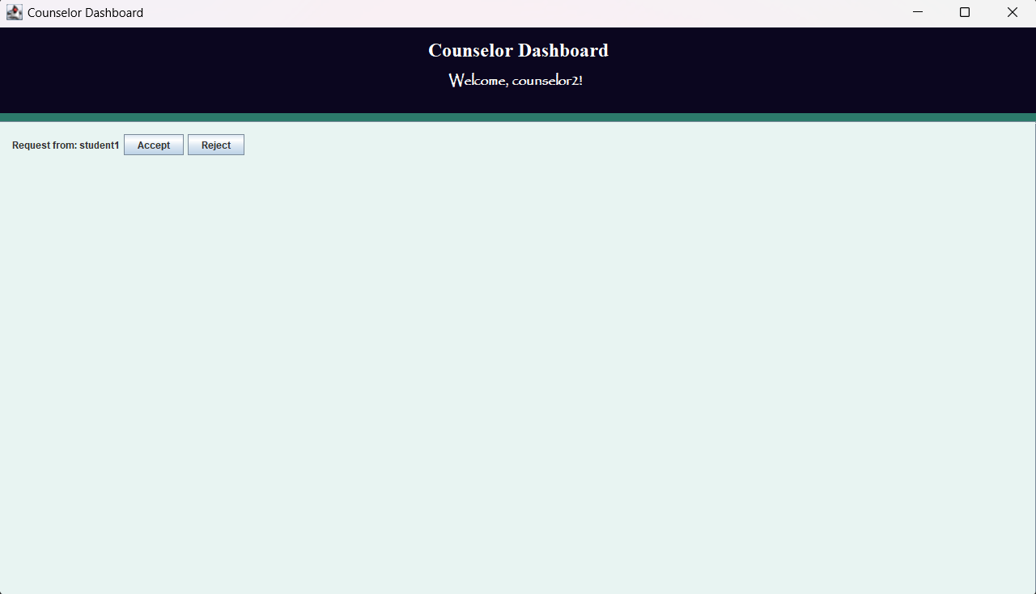
C. Counsellor Dashboard
Counsellor Dashboard-general layout
Counsellor Dashboard-with a pending request

Slide 17
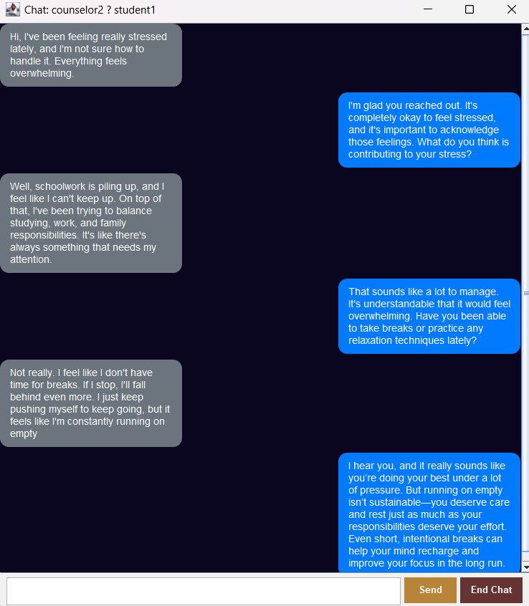
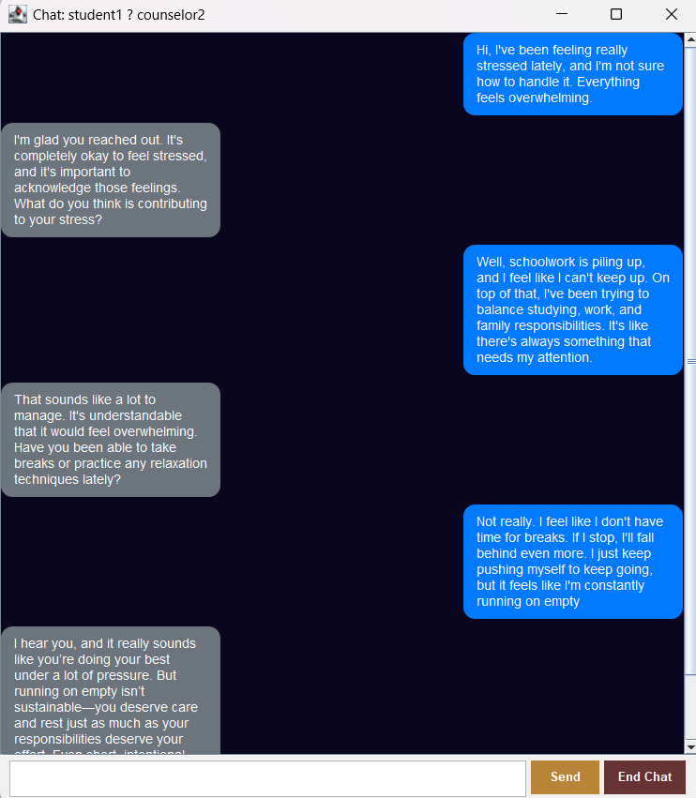
D. Chat UI Window
Counsellor Chat Window
Student Chat Window

Slide 18
Conclusion
Developed a secure chat platform for students and counsellors.
Implemented role-based login system (student/counsellor).
Ensured message privacy using AES encryption.
Enabled real-time communication with a user-friendly interface.
Demonstrated integration of security and usability in a chat system.
The system is scalable, reliable, and meets core project objectives.

Slide 19


Slide 20

Thank You

